Slide 1
Team 9 - The Jordans
Fernanda Rangel
Jan Castillo
Diego DuVall
Marco Solorzano

Slide 2
Justification
Basketball is one of the most popular sports in the world, especially in North America.
This sport is rich in all kind of statistics, it permits to have a very good analysis
We think that the performance of a player is determined by the position of the player, thus, some positions always will have better performance than others.

Slide 3
Our Hypothesis
1.- The effect of the age factor in the performance varies depending on the player’s position.
2.- Players with more experience will have a better factor
3.- Investment pays back because players with grater salary have a better performance

Slide 4

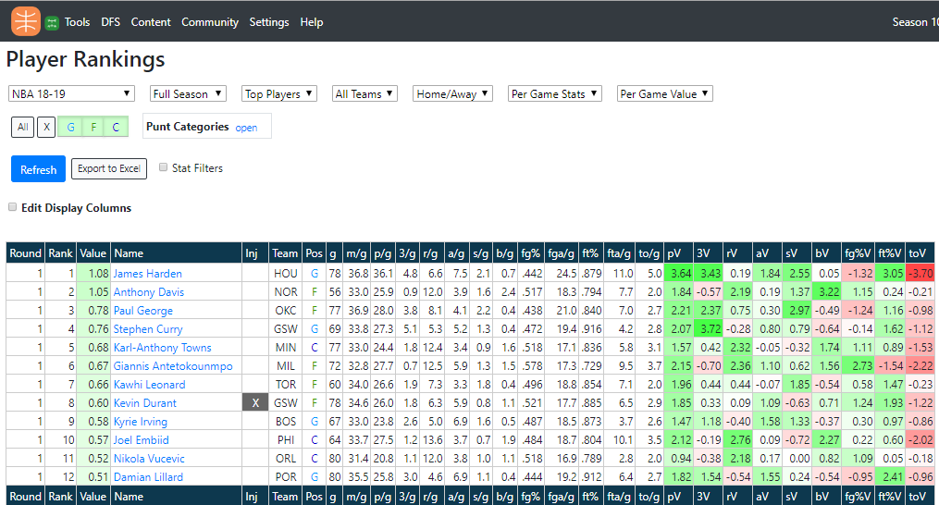
Our data sources
Basketball Monster
API - NBA

Slide 5
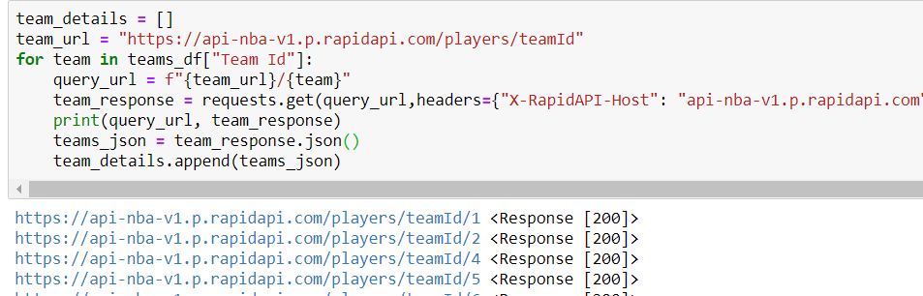
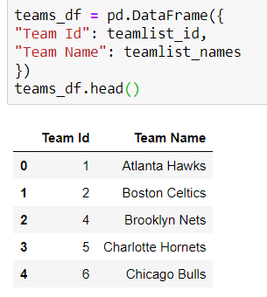
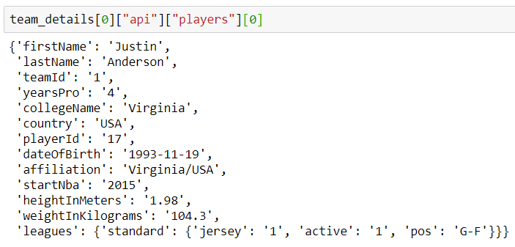
Exploration and Cleanup Process
Notes:
Jan

Slide 6
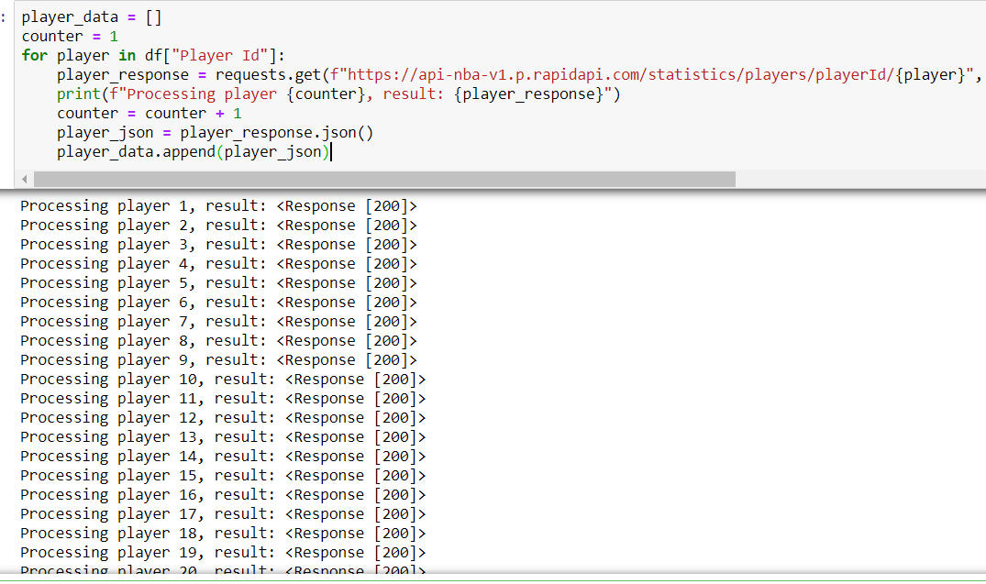
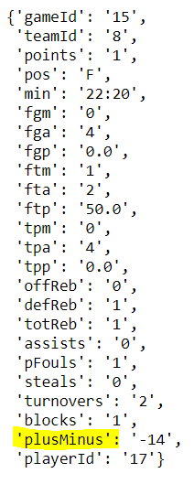
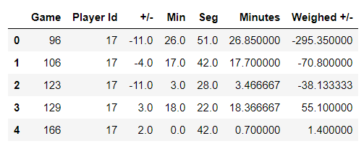
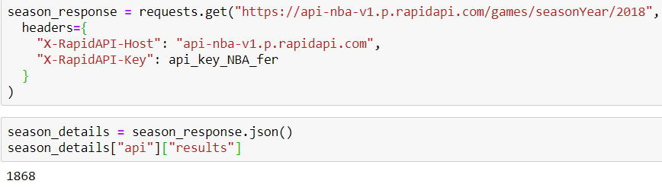
Notes:
Jan

Slide 7
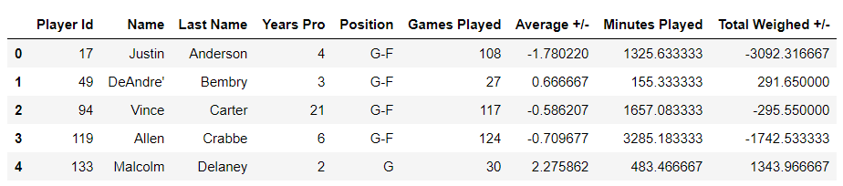
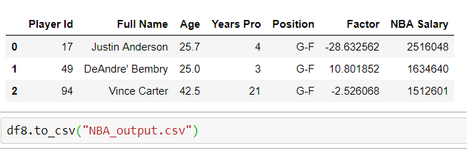
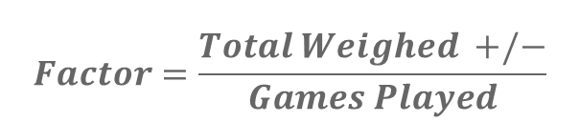
$$Factor=\frac{Total Weighed +/−}{Games Played}$$

Slide 8
Analysis process (jupyter notebook)
Notes:
Diego

Slide 9
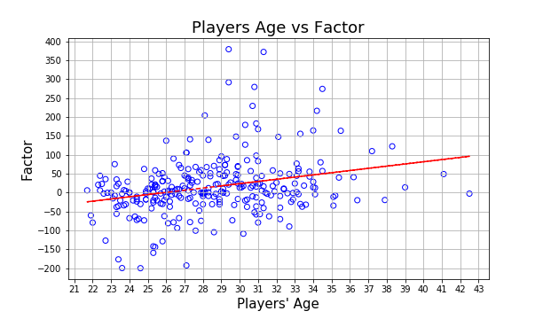
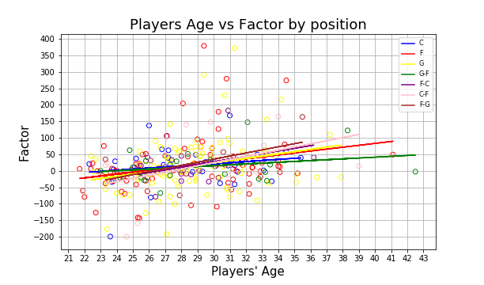
Age vs factor
Graph 1.1
Graph 1.2
Positive relation between factor and the age of the player
Notes:
Diego

Slide 10
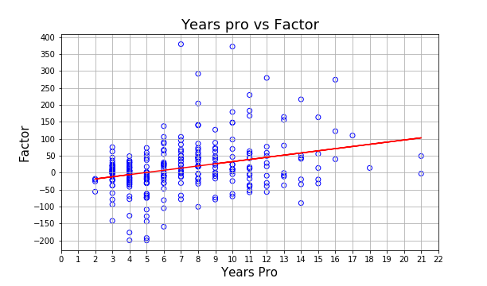
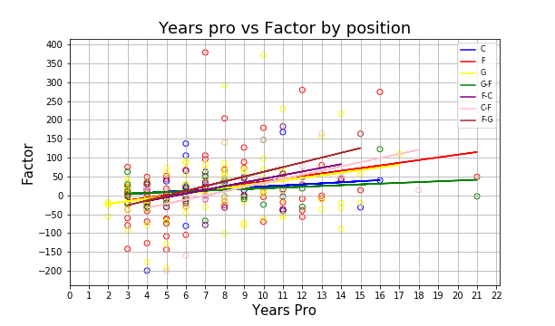
Years Pro vs factor
Graph 2.1
Graph 2.2
Positive relation between factor and how many years a player have been professional
Notes:
Diego

Slide 11
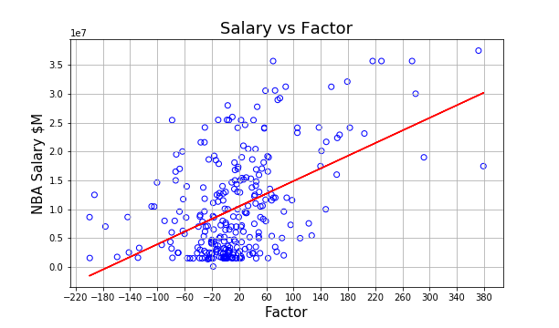
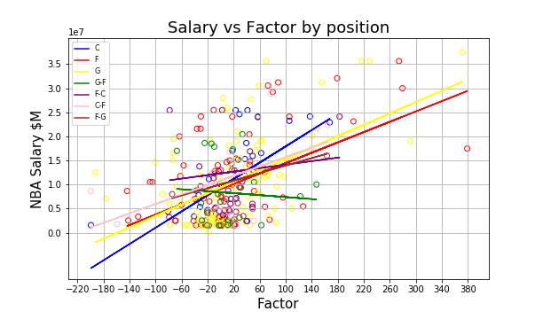
Salary vs factor
Graph 3.1
Graph 3.2
Also positive relation, but this time we can appreciate a stronger relation (grater slope) between our factor and how much do players earn per year
Notes:
Diego

Slide 12
Implications of your findings: what do your findings mean?
“F” position have a really good age range and is well paid
The effect of the age factor in the performance varies just a little between positions
A greater factor depends more on how many years a player have as pro instead of how old he is
It could be said that money could pay for talent in this sport

